Slide 1

SPRING 2022 CAPSTONE PROJECT
GUIDED BY:- PROF HENRY WONG

Slide 2
Agenda
For the project to be successful, there must be interaction, attendance, cooperation, teamwork, and attention from every team member
This meeting's goals are to assess our progress toward our deadlines, agree on future directions, remove obstacles, and coordinate next steps for development.
Discussions about timely submission. Making note of significant dates. Getting all the events added to a group calendar.
Factors to Consider: volunteers, experience, expertise, desire to learn and work, etc.
Verify client needs, i.e., consider and research all the elements that our project would require from the client's perspective. Describe the dangers.

Slide 3
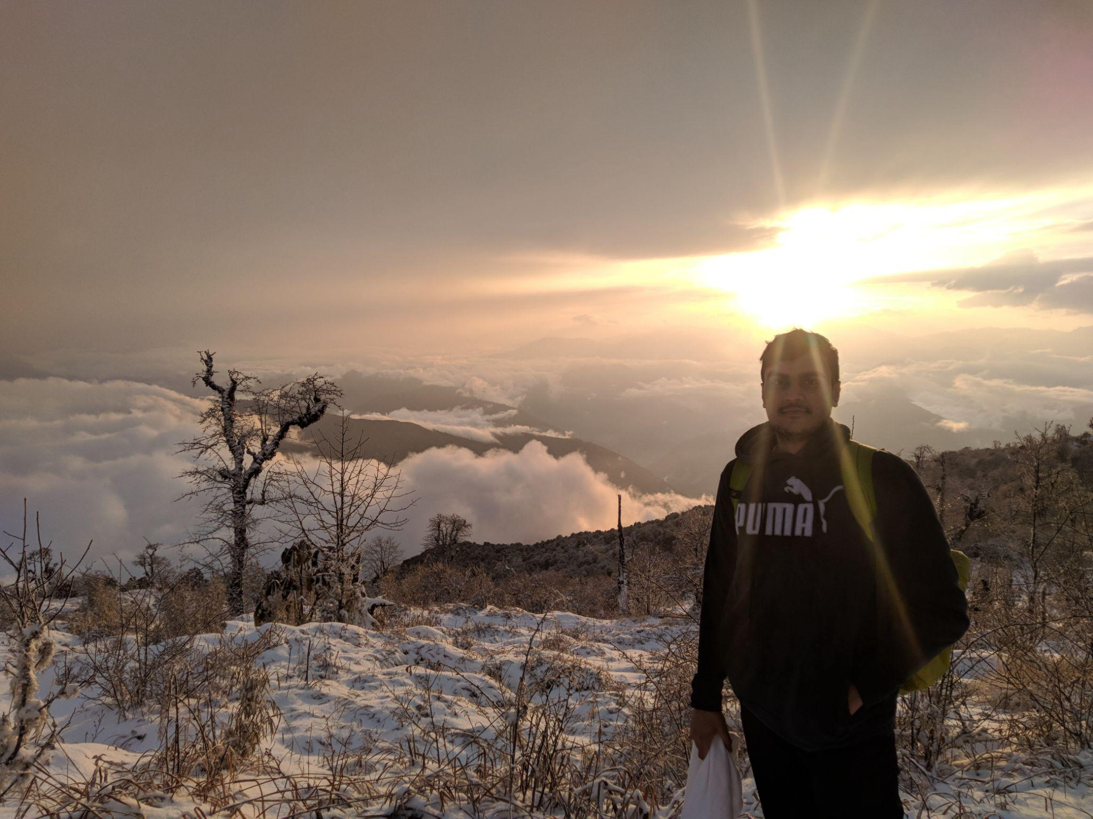


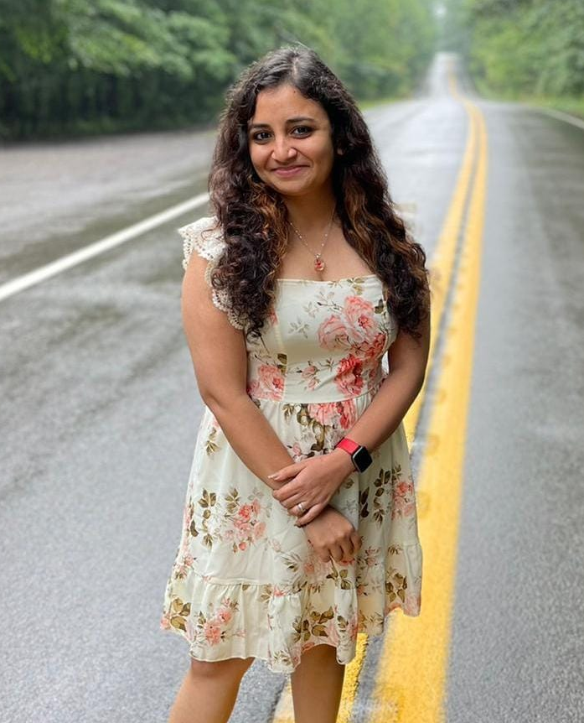
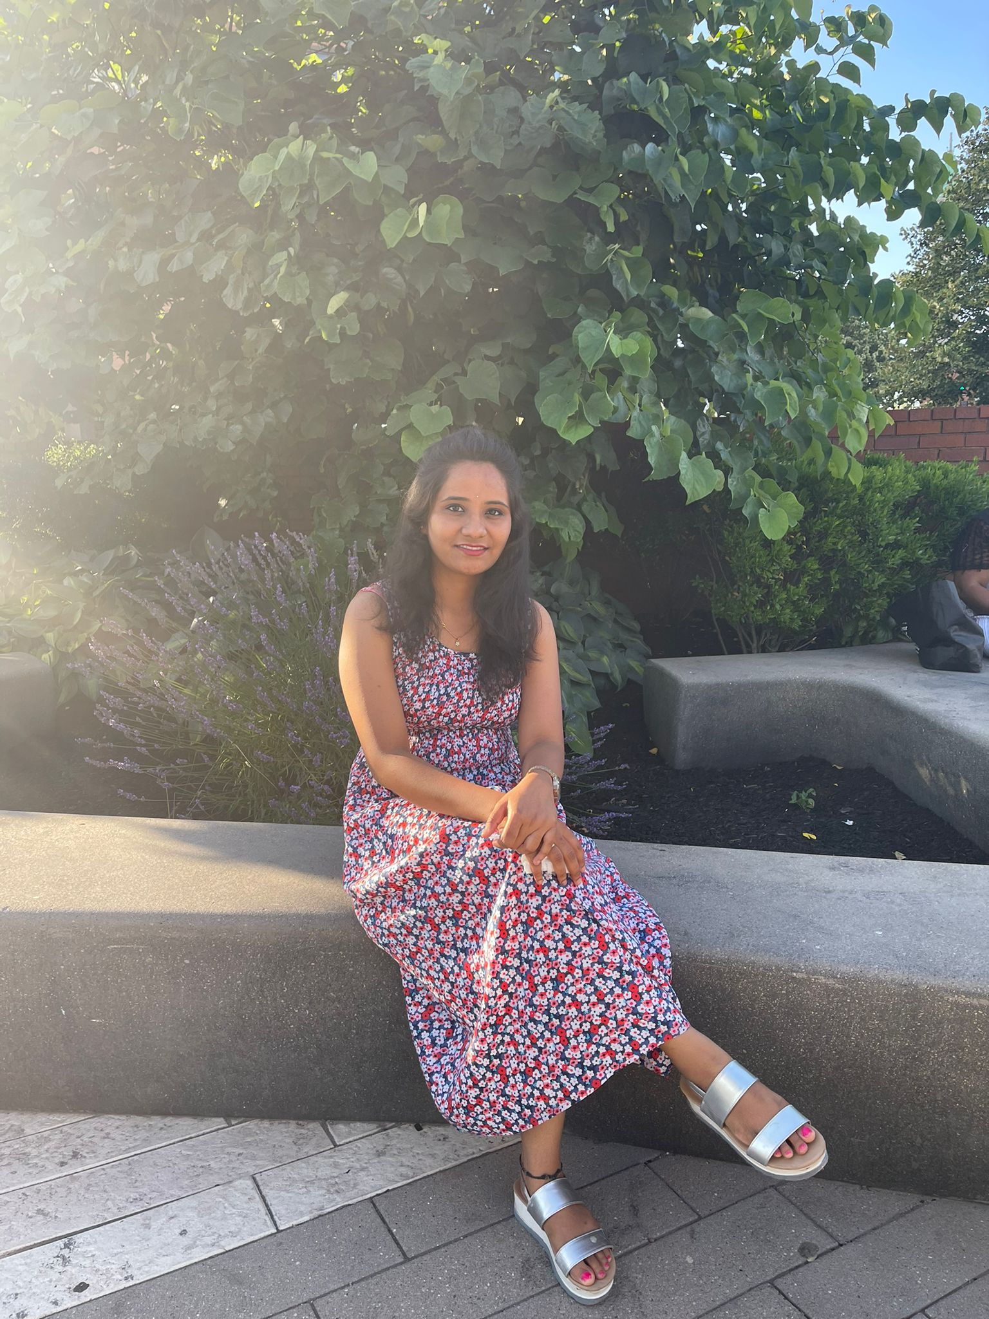
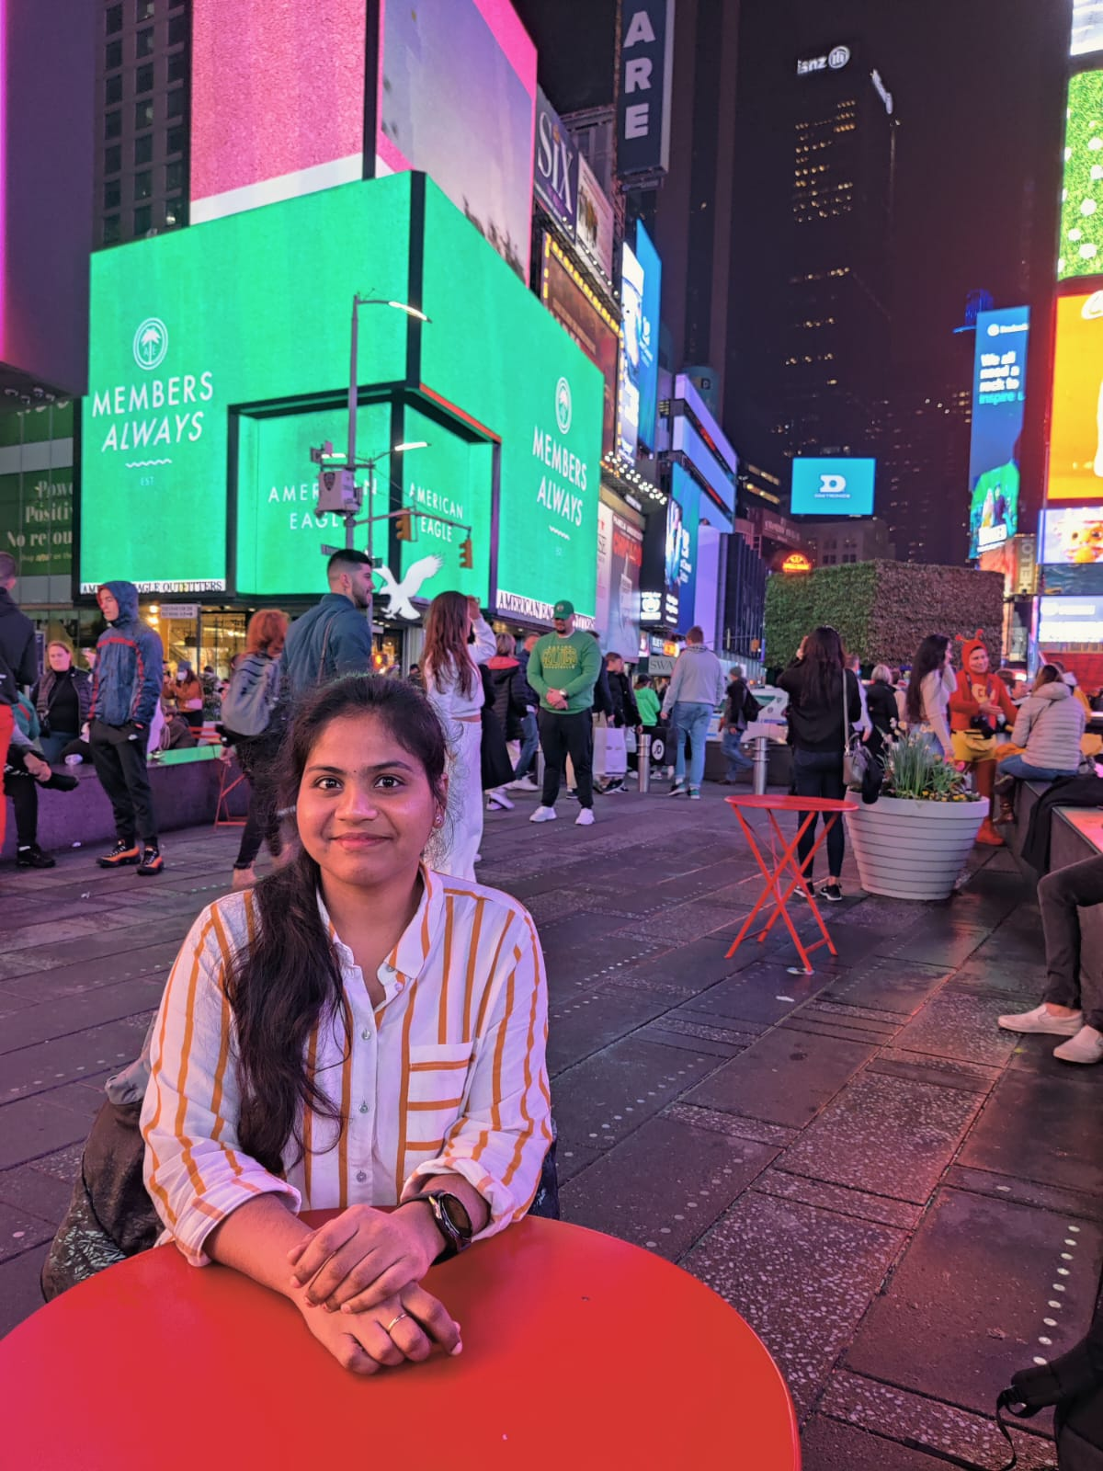
Accountabilities
AMIT BHAYAL ANKUSH GURHANI GENIUS MACHADO
(Software Developer) (Software Developer) (Software Developer)
SHARANYA DAVE SRAVANI EATA USHA TIRUMALASETTY
(Database Administrator) (Business Analyst/Software Tester) (Software Tester / SDE 2)

Slide 4
IMPROVEMENTS MADE FROM PROFESSOR’S FEEDBACK
Team contract changed to Team working Agreement
Roles and Responsibilities changed to accountabilities.
Added the Wiki page link at the end.

Slide 5

Problem Statement
How Students and Parents know the objective of the subjects taught in the class ?
How the teachers and the student communicate with each other after the school hours ?
How the Parents monitor their kids assignments and learning material ?
How the current system can notify the user about any updates just in time ?

Slide 6

Notes:
Just put an image for god sake

Slide 7

A learning management system (LMS) is a software that is designed specifically to create, distribute, and manage the delivery of educational content.
The LMS can be hosted as a stand-alone product on the company server, or it can be a cloud-based platform that is hosted by the software firm.
The goal of this project is knowledge management which means gathering, organizing, sharing and analysis of an organization's knowledge/resources.

Slide 8

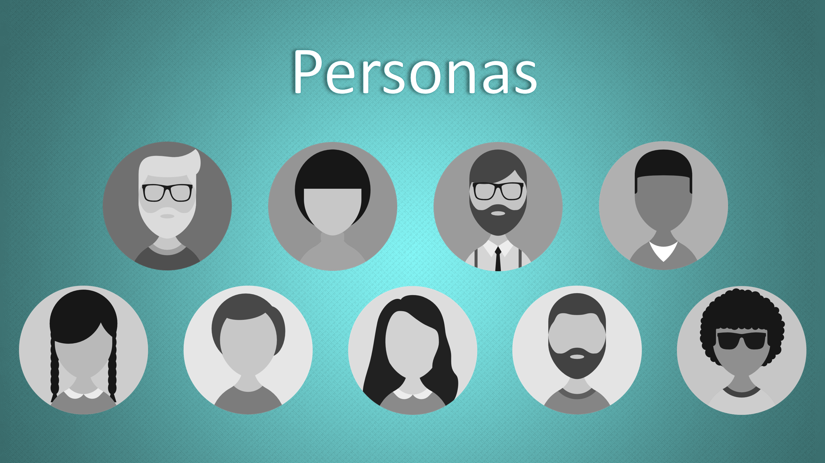

Slide 9

Persona -1:
Name :- Debora Banerjee
Job Role/Description :- Admin / Principal
Age :- 34
Debora manages teams of teacher’s, each teacher has 40 students assigned to her.
As the admin / Principal she overlooks the activity of the teachers and provides help when needed
Ensuring a standard curriculum is being followed through the institute.
Providing resources for the teachers to update according to the changing market scenario.

Slide 10

Persona -2:
Persona :- David
Job Role/Description :- Teacher
Age :- 29
He teaches Mathematics.
As a teacher, it’s his responsibility to prepare lesson plans and make courses available to the students on time and collect deliverables from the student.
Also grading them accordingly in the given time frame.
Along with this he has to maintain the progress report of each student.
Prepare annually grade report for each student.

Slide 11

Persona -3:
Name :- Dom
Role/Job Description :- Student
Age :- 19
As a student, it is his responsibility to manage his course work and keep track of his deadlines.
Meeting the requirements to receive the desired grades.
Completing a degree that will help him reach his career goal.
Getting accepted at his top choice of college.

Slide 12
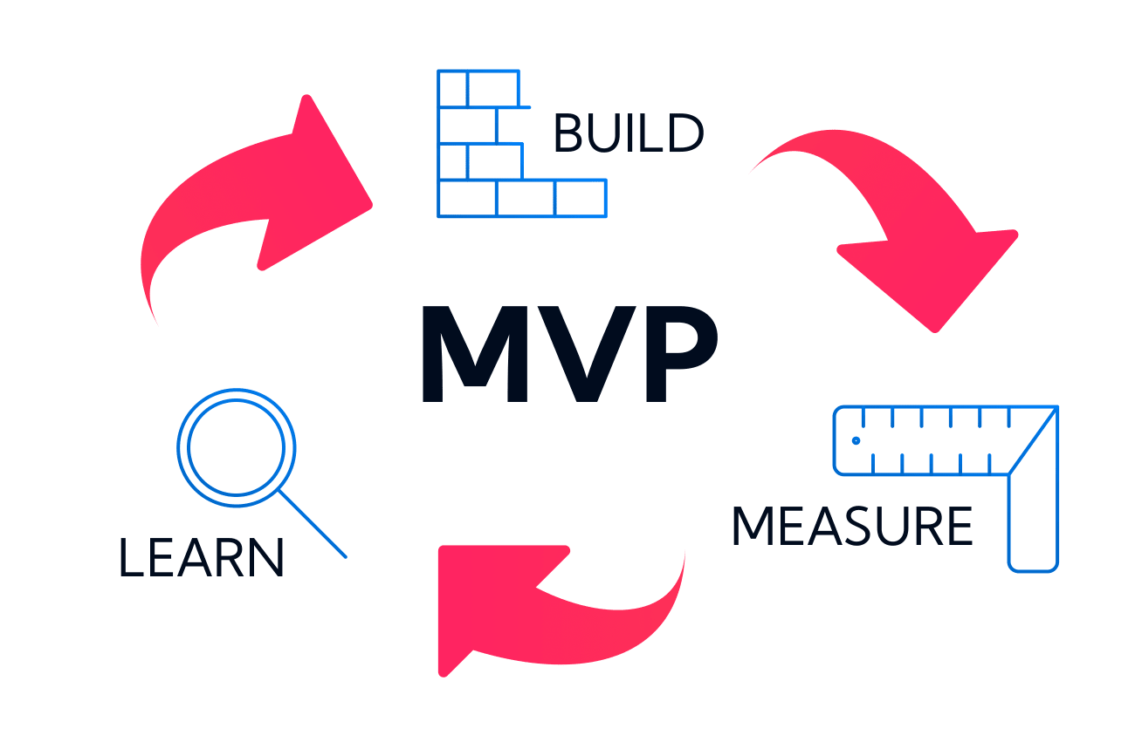

Slide 13
MINIMAL VIABLE PRODUCT(MVP)
Login - User can login into the application with valid credentials
Registration/Signup - User can register into application
Homepage - User can view the course
Logout - User can log out from the application
Add course - User can add the courses into the application
Delete course- User can delete the courses from the application
Cart - Courses selected by the students are stored in the cart.

Slide 14












Technologies

Slide 15
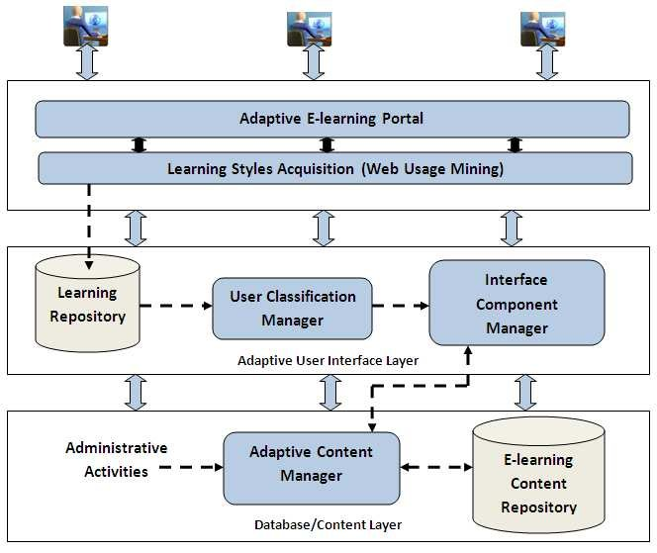
Conceptual Architecture Diagram

Slide 16
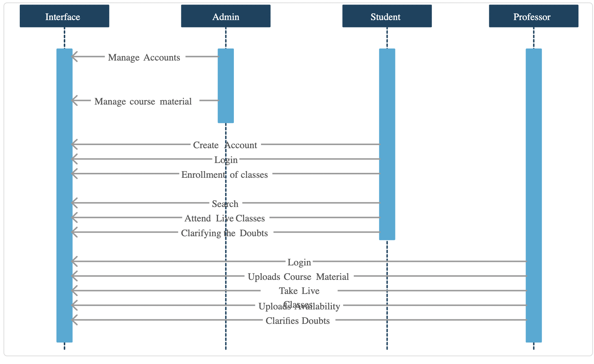
Sequence Diagram

Slide 17

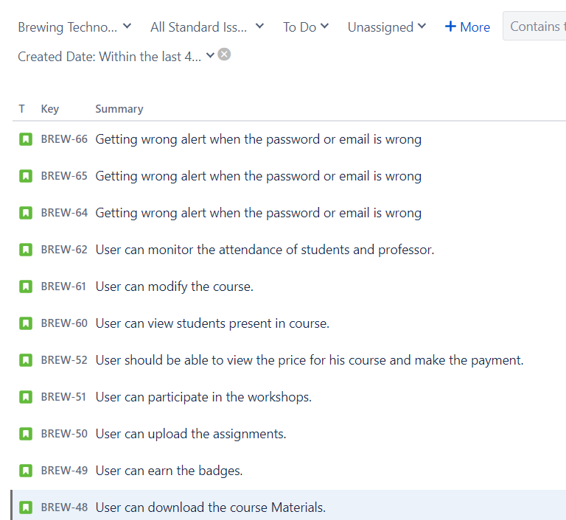
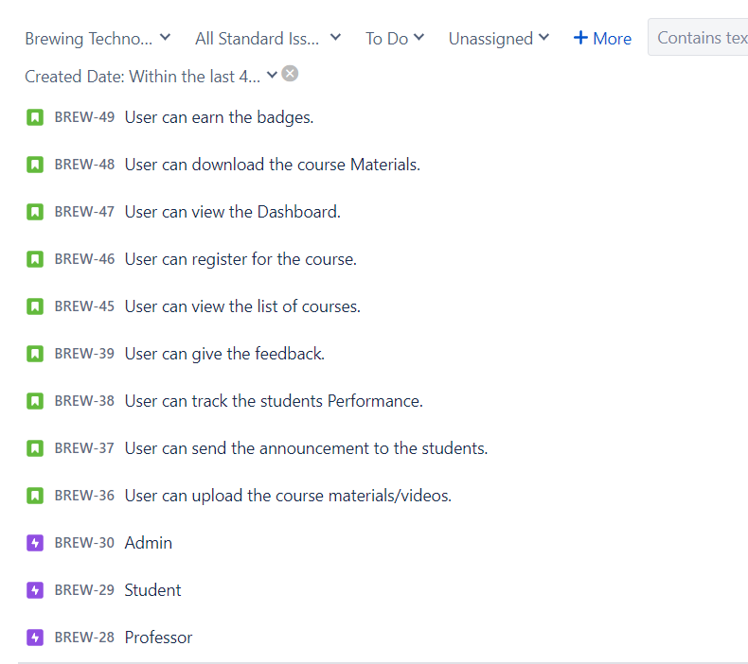

Slide 18
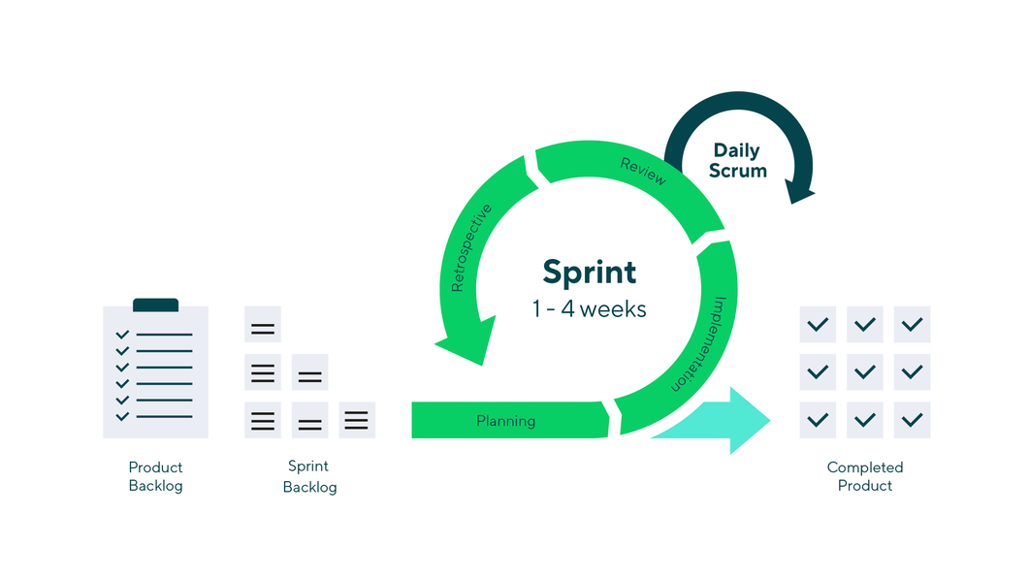
Sprint Schedule

Slide 19
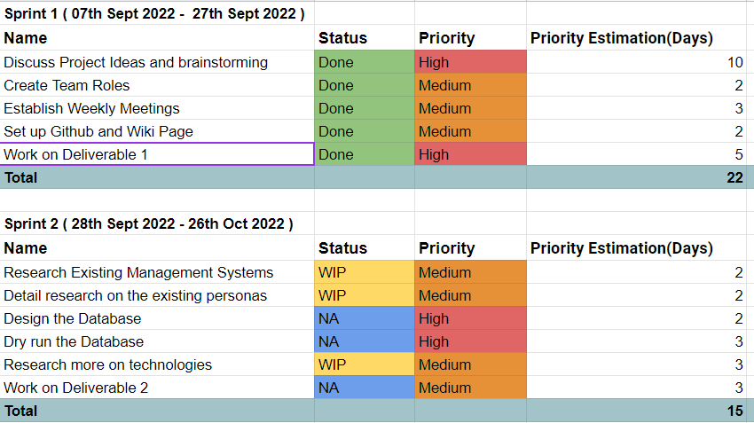

Slide 20
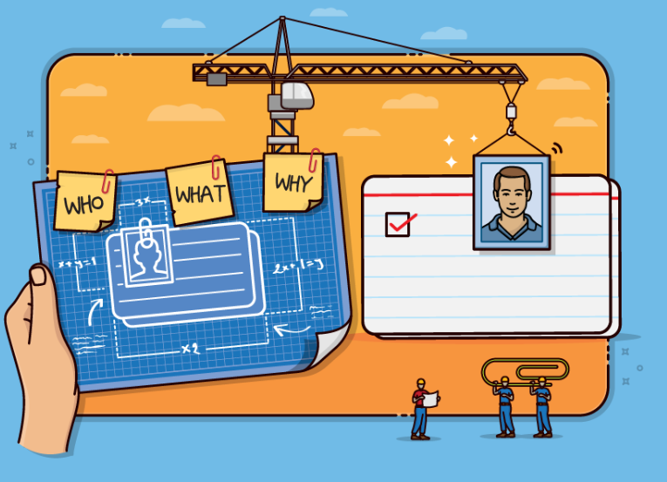
User Stories

Slide 21
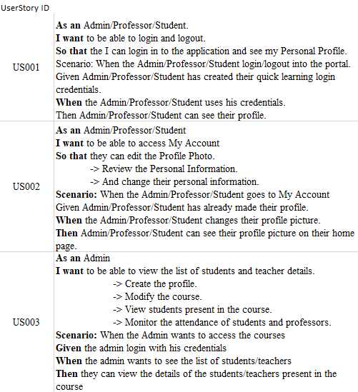

Slide 22
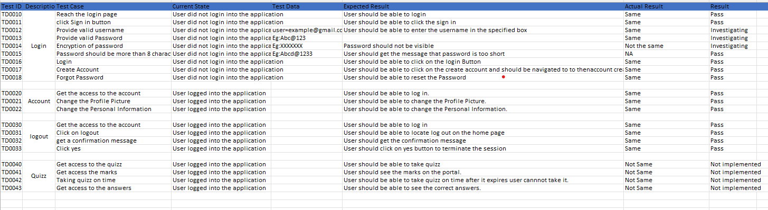

Slide 23

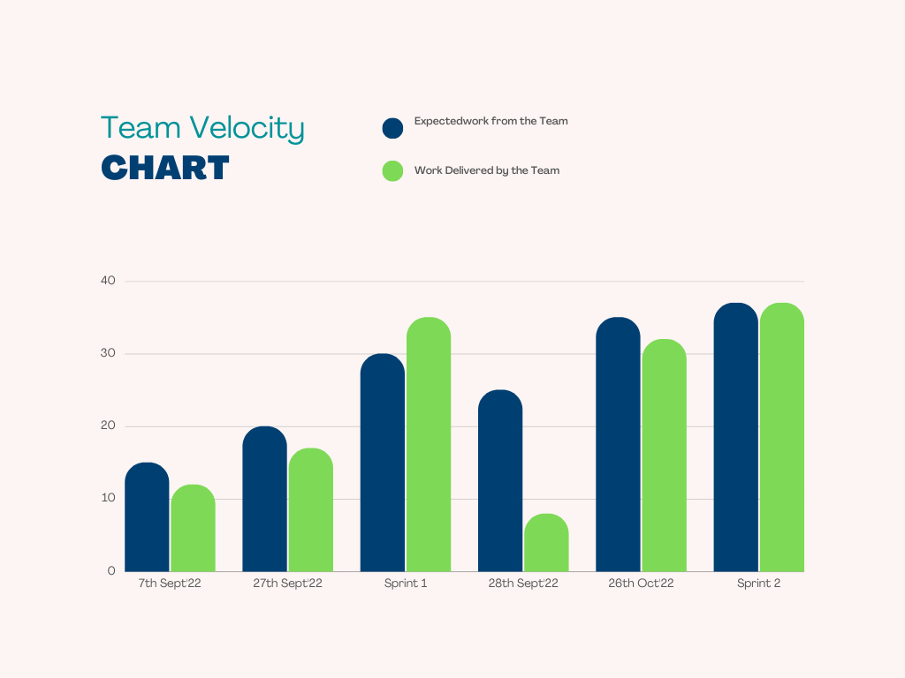
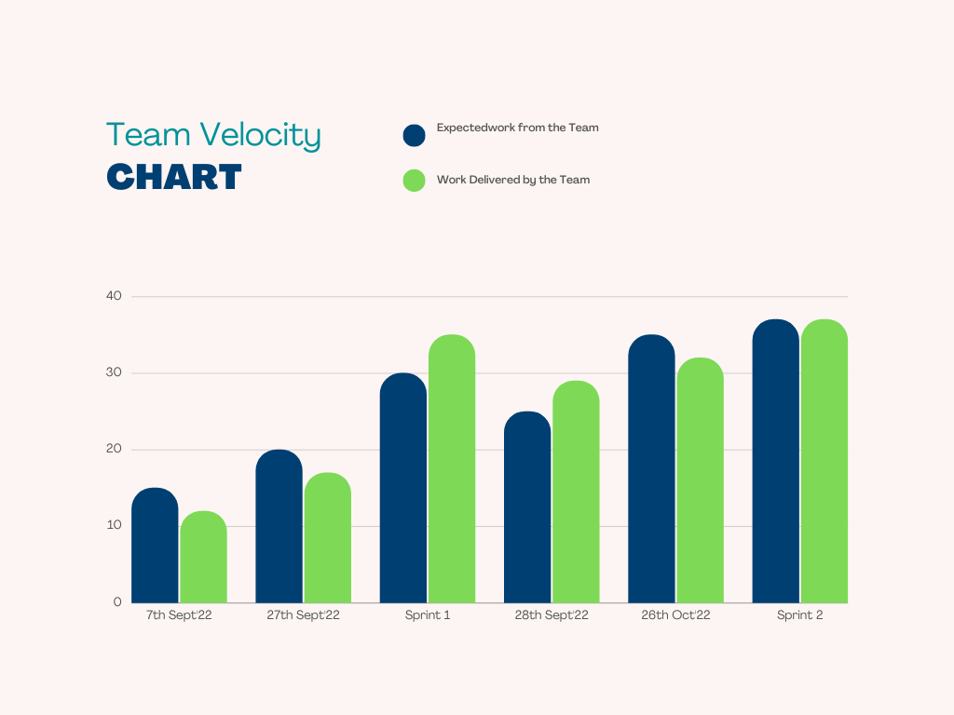
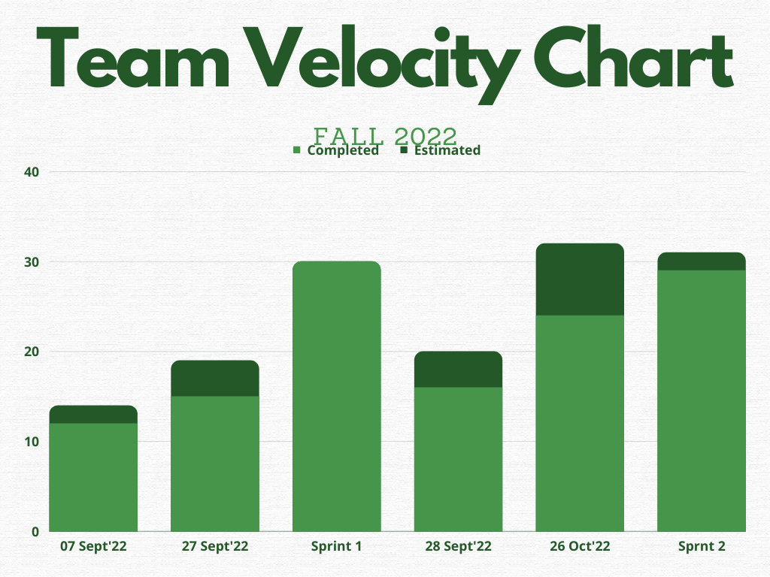
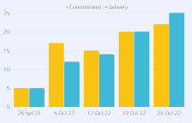
Team Velocity Chart
The bar below describes the growth of our project during 28th Sept - 26th Oct 2022.
This chart shows more in depth analysis of timeline productivity where our team was able to keep up the deliverance with the expectation.

Slide 24
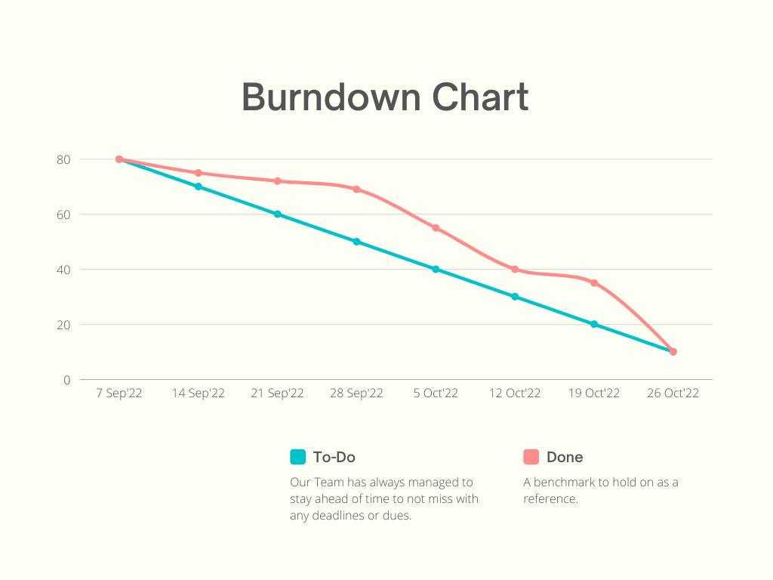
Burndown Diagram
Our Team has always managed to stay ahead of time to not miss with any deadlines or dues.
Blue line is the benchmark to hold on as a reference.

Slide 25

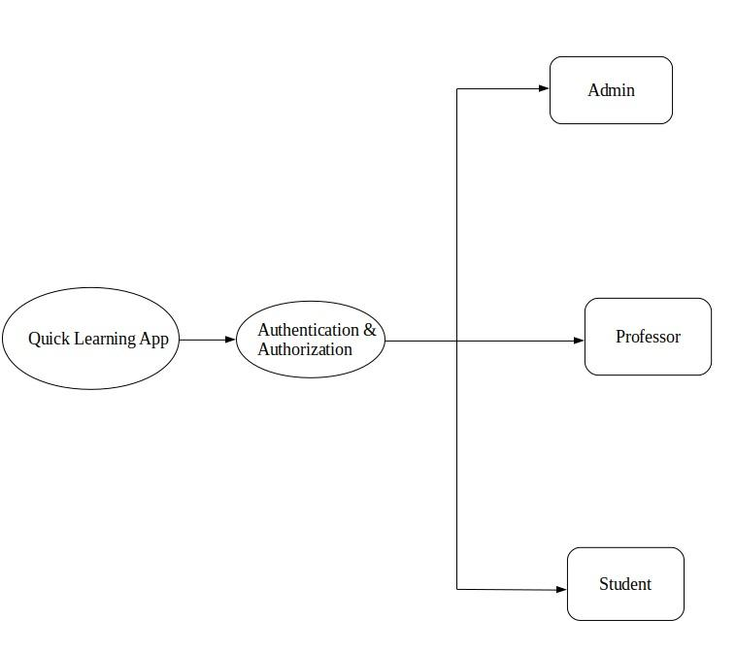
Product Cycle

Slide 26
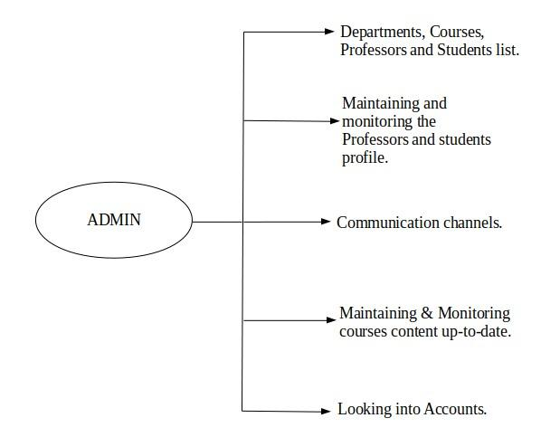

Slide 27
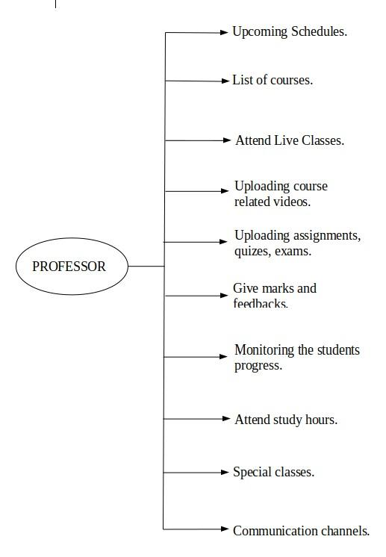

Slide 28
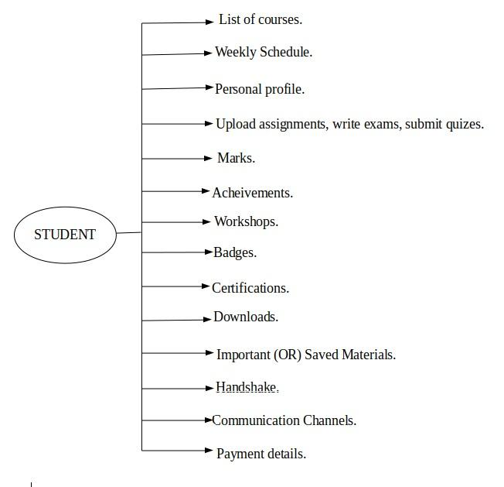

Slide 29
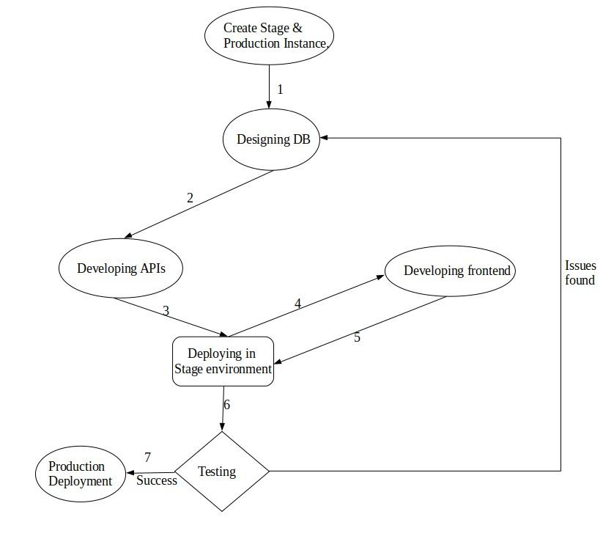
Product Development Cycle:

Slide 30
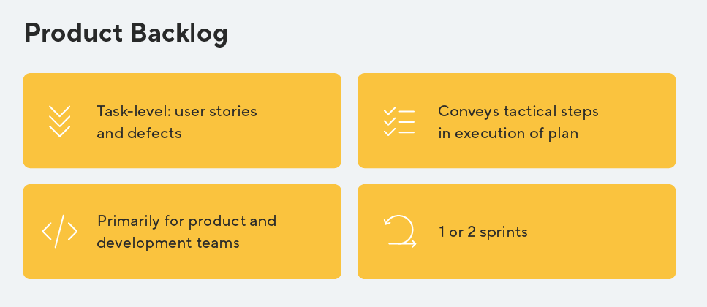

Slide 31
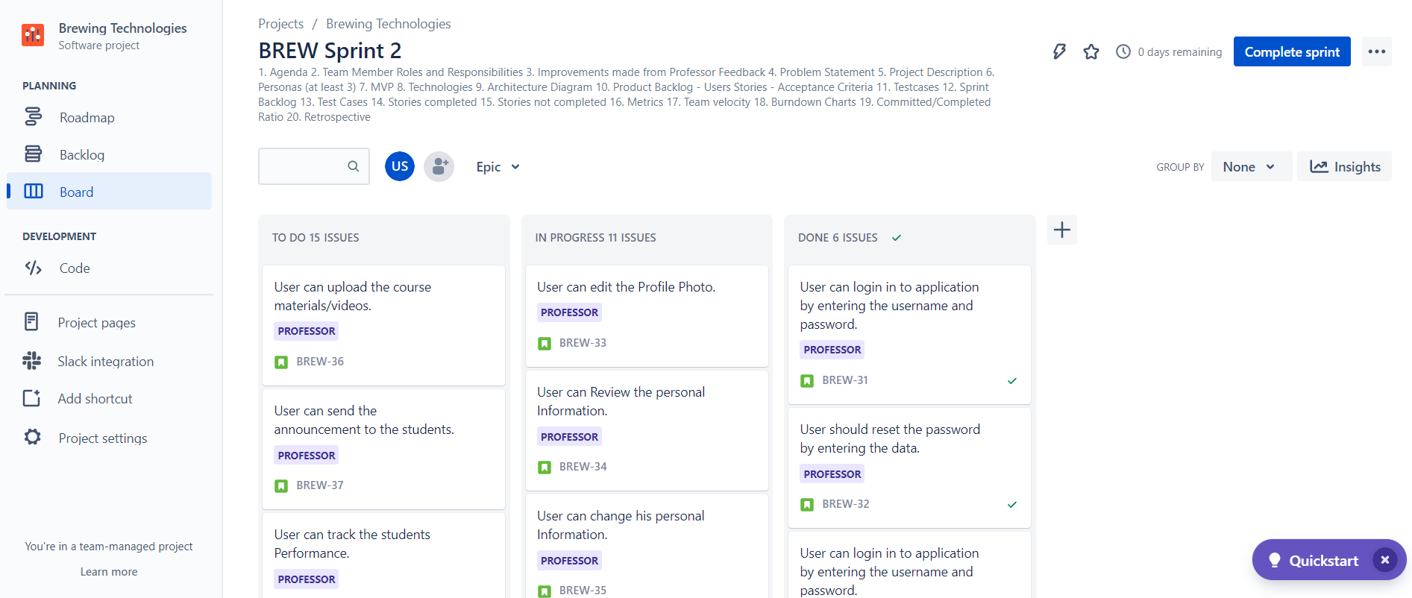
Product Backlog:

Slide 32
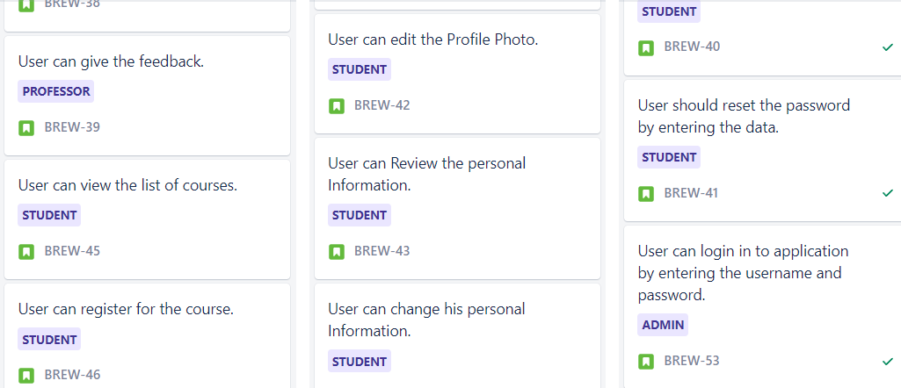
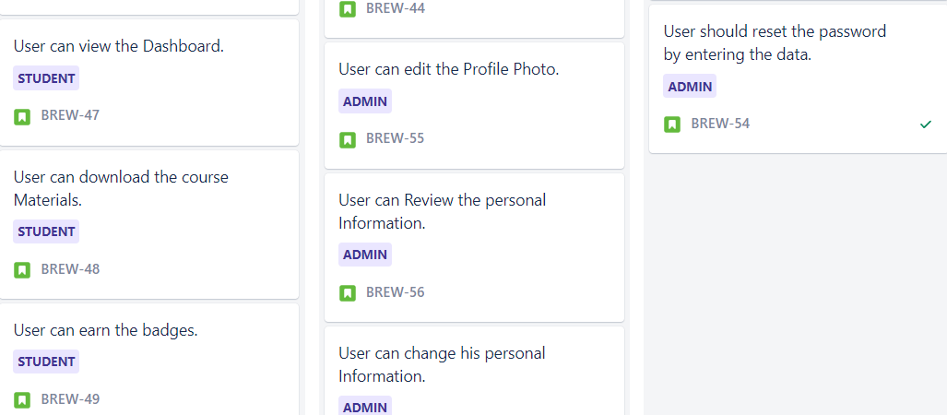

Slide 33
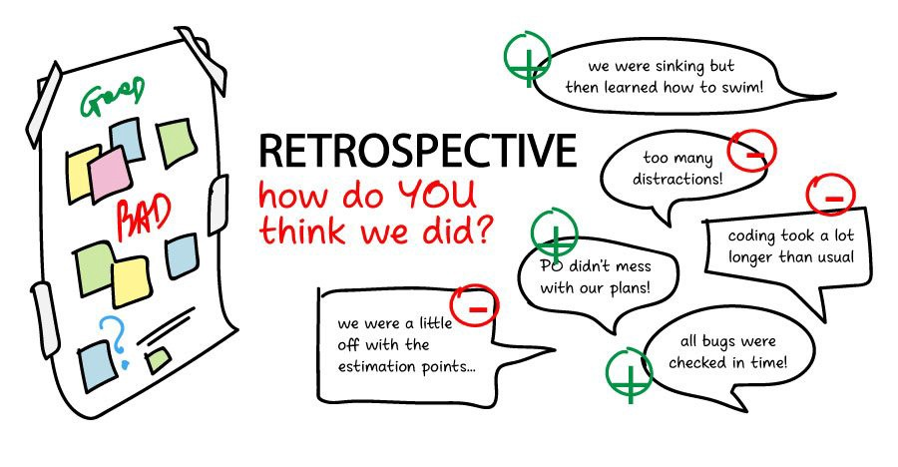

Slide 34

WHAT WENT WRONG ?
Lack of automation of tasks.
Enabling Version control.
Flooding the system with unwanted tools.
Submission of user stories were delayed this time.
Time Schedule not matching.

Slide 35
WHAT WENT RIGHT ?
Having a open communication channel.
Having a clear vision.
Recognizing and motivating each other.
We did our research on all the topics including the tools and technologies used.
Adapting to the new communication channels(Slack, Jira).

Slide 36

Happy
Learning!

Slide 37
Wiki Page Link
https://github.com/BrewingTechnologies/QuickLearning/wiki/Home/

